Slide 1
Artificial Intelligence
Enrique Peláez Ph.D.

Slide 2
Agenda
Management of Uncertainty
  Introduction to Fuzzy Logic

Slide 3
Introduction to Fuzzy Logic

Slide 4
Introduction to Fuzzy Logic
Fuzzy Logic) was created in 1965 as an alternative for the 2 value logic, probability theory, and the traditional notion of membership and logic.
Fuzzy Logic considers the two value logic and the set theory as special cases of a more general and multi value theory.
Fuzzy Logic is not using frequencies, but truth values that represent how certain is a fact, based on a membership degree of a function.

Slide 5
Introduction to Fuzzy Logic
Fuzzy Sets – Formal definition
If X is a set of objects, with elements represented as x. A fuzzy set Ã, in X, is characterized by a membership function m Ã(x) that maps each object of Ã, in the interval of real numbers [0, 1].

Slide 6

Introduction to Fuzzy Logic
Classic
Fuzzy
~
A
A
?x
?x

Slide 7
Introduction to Fuzzy Logic
Formally:
Let’s X be a classic universe set, such that x are its elements, A fuzzy set Ã is:
Ã = { ( x, m Ã(x) ) | x ∈ X }
Where: m Ã(x): membership Function

Slide 8
Introduction to Fuzzy Logic
Examples:
A: Set of young people
B: Set of middle age people
C: Set of old people
Each set has not clear limits.
Fuzzy sets can be used to represent uncertainty, imprecise quantities and limits.

Slide 9
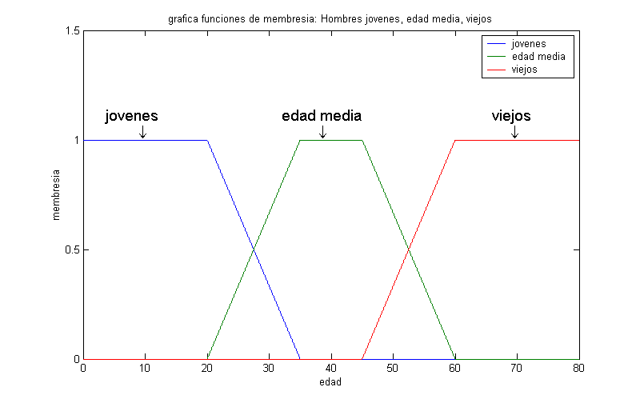
Introduction to Fuzzy Logic

Slide 10
Introduction to Fuzzy Logic
Types of membership functions

Slide 11
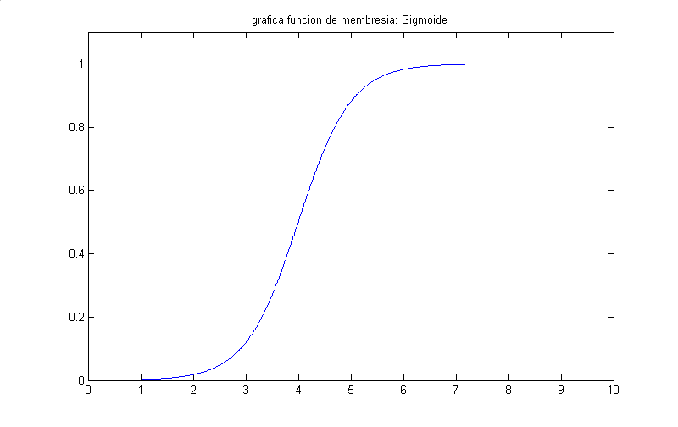
Introduction to Fuzzy Logic

Slide 12
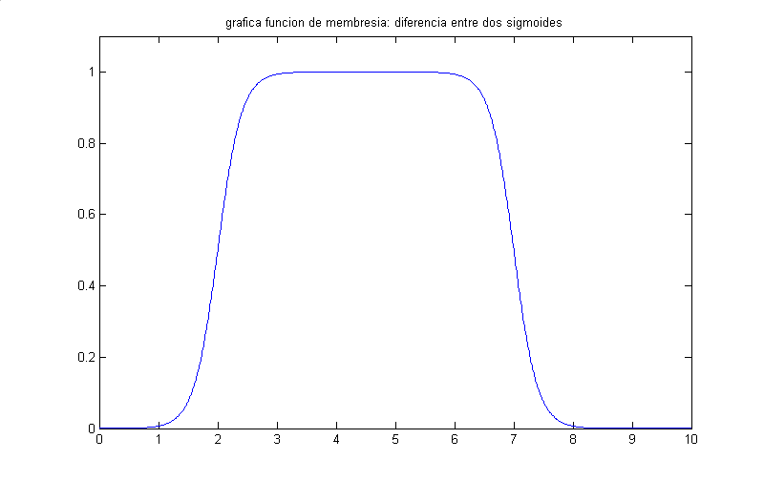
Introduction to Fuzzy Logic

Slide 13
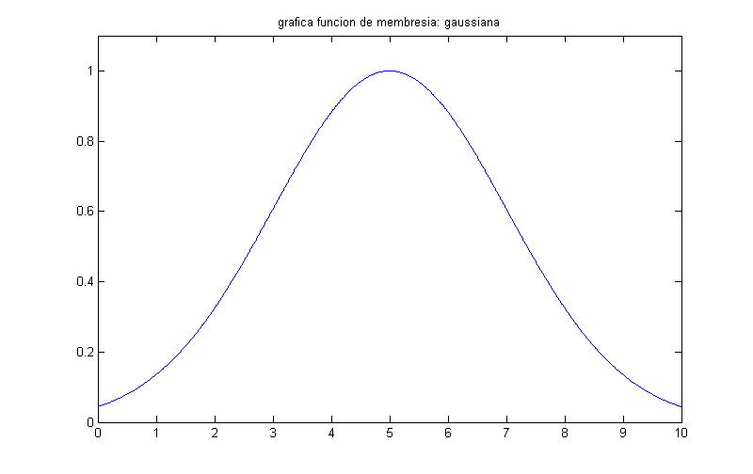
Introduction to Fuzzy Logic

Slide 14
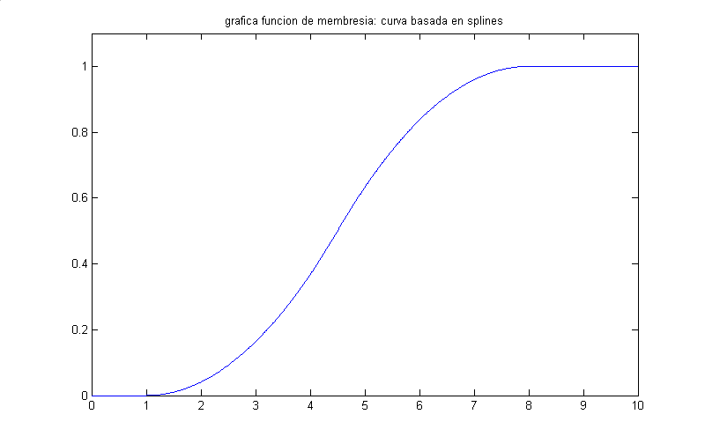
Introduction to Fuzzy Logic

Slide 15
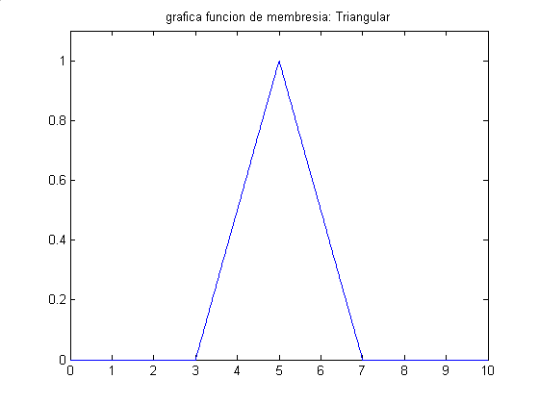
Introduction to Fuzzy Logic

Slide 16

Introduction to Fuzzy Logic
~
1.0
A
~
~
A
~
~
A
~
0.5
A
0
Complement

Slide 17

Introduction to Fuzzy Logic
~
~
1.0
~
~
AUB
A
B
~
~
0.5
A
B
0
Union

Slide 18

Introduction to Fuzzy Logic
~
~
1.0
A
B
~
~
0.5
A
B
~
~
0
Α
Β
Intersection

Slide 19
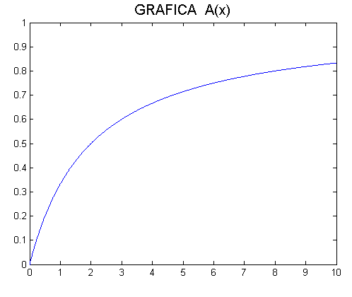
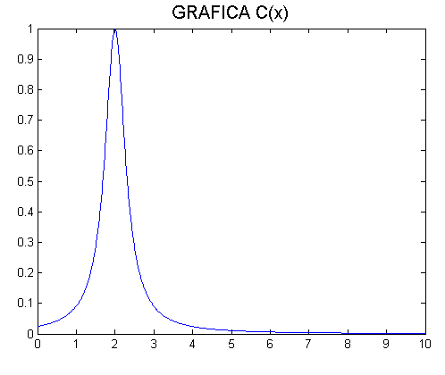
Introduction to Fuzzy Logic

Slide 20
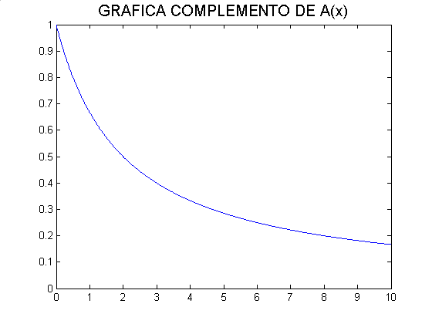
Introduction to Fuzzy Logic

Slide 21
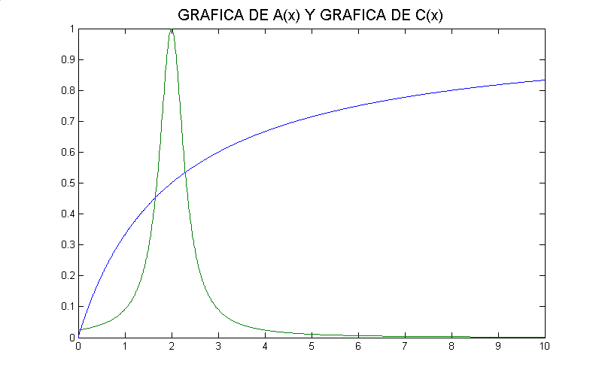
Introduction to Fuzzy Logic

Slide 22
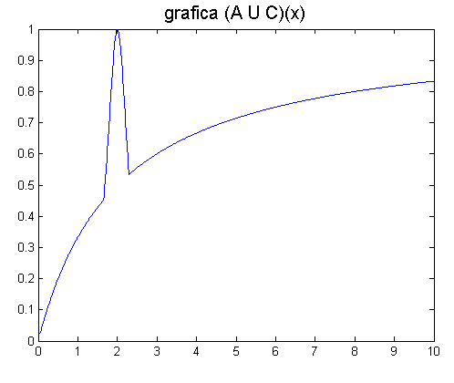
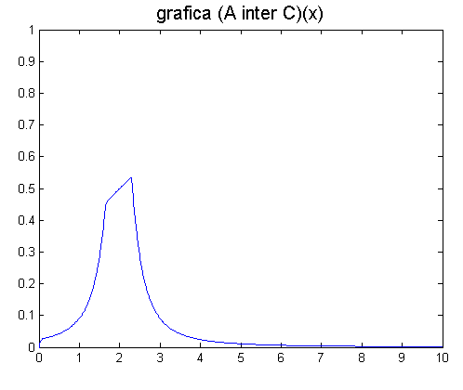
Introduction to Fuzzy Logic

Slide 23
Introduction to Fuzzy Logic
Linguistic Variables
Have the same meaning as numerical variables, but the values they hold are linguistic.
Example:
If X is a linguistic variable called Age, the values of this variable could be:

Slide 24
Introduction to Fuzzy Logic
Linguistic Variables
Have the same meaning as numerical variables, but the values they hold are linguistic.
Example:
If X is a linguistic variable called Age, the values of this variable could be: old, young, very old, etc.

Slide 25
Introduction to Fuzzy Logic
child
young
adult
old
1.0
0
Age
0
25
50
75
100

Slide 26
Introduction to Fuzzy Logic
Concentrator
mCÃ(x) = [mÃ(x)]²
Fuzzifier
mDÃ(x) = [mÃ(x)]^{1/2}
Example:
Juan is tall: mÃ(x)
Juan is very tall: m “very” Ã(x) = [mÃ(x)]²
If m “old” (Juan) = 0.95; then
m “very old” (Juan) = 0.903
Juan is more or less old
m “more or less old” (Juan) = 0.97

Slide 27
Introduction to Fuzzy Logic
Very low
low
+/-low
moderate
high
1.0
bien-baja
0
36
37.5
38.5
40
45
ο
C

Slide 28
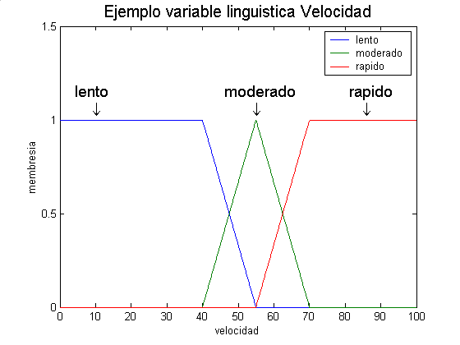
Introduction to Fuzzy Logic

Slide 29
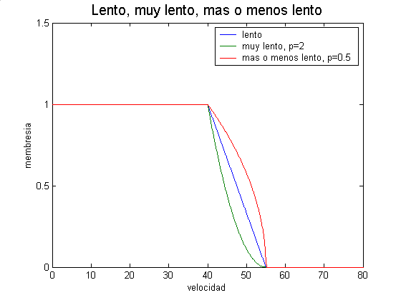
Introduction to Fuzzy Logic

Slide 30
Introduction to Fuzzy Logic
Fuzzy Logic has become one of most successful theories in the world of high tech, specially in control and decision support systems; to handle complex requirements.
Fuzzy control systems are simple to implement, maintain and less costly than conventional systems.

Slide 31
Introduction to Fuzzy Logic
Fuzzy Logic has become one of most successful theories in the world of high tech, specially in control and decision support systems; to handle complex requirements.
Fuzzy control systems are simple to implement, maintain and less costly than conventional systems.
When is appropriate to use Fuzzy Logic?

Slide 32
Introduction to Fuzzy Logic
When one or more variables are continue;
When the mathematical model of the process does not exist, or does exist, but it is too complex or difficult to code;
When the analysis of input values and model evaluation is complex that the conventional control system is not fast enough to respond in real time;
When the solution involves too many resources;
When the noise in the environment is high;
When there exist an expert and is available to specify the behavioral rules of the expected of the system.

